Slide 1
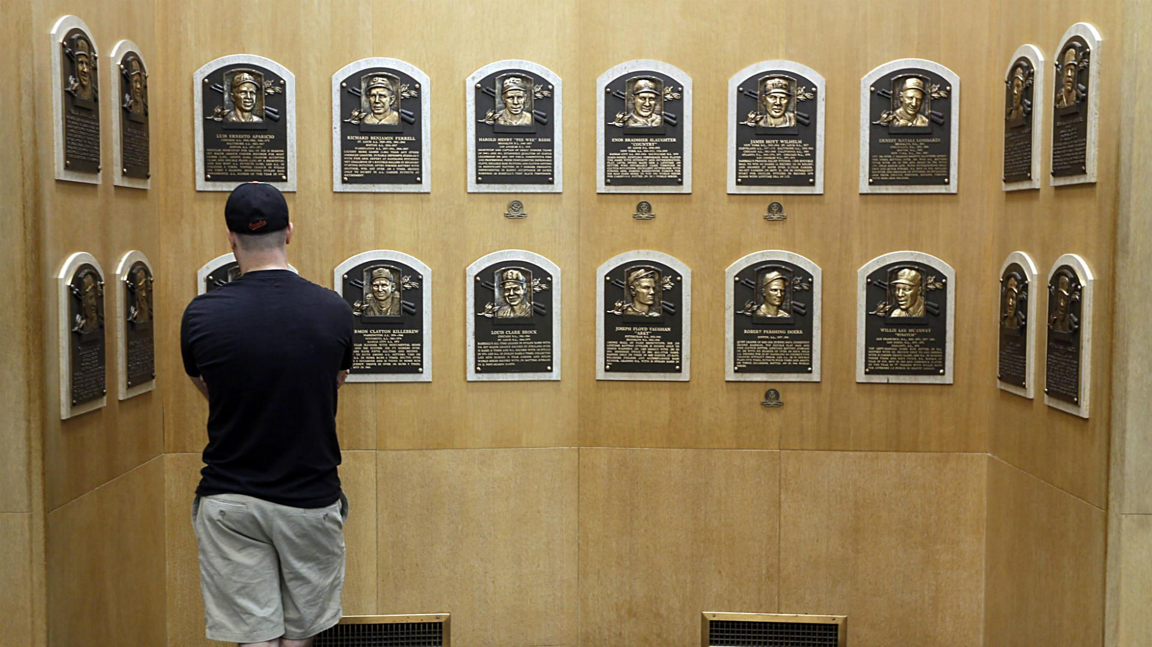
The Long Road to Cooperstown
Who conducts the voting?
How selective is induction?
How long can the journey take?
Can a player succeed without being inducted?
Stakeholders: Baseball Historians, voters, journalists, and fans
Exploring Baseball Hall of Fame Voting
Presented by: Prashant Aryal and Rubash Mali

Slide 2
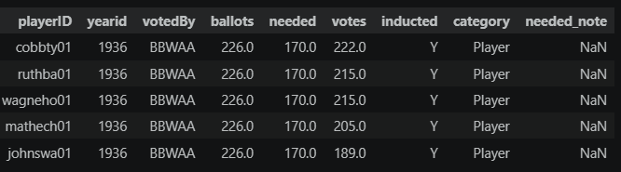
Understanding the Hall of Fame Dataset
One Row Represents One Election-Year Record
4,191 Hall of Fame records
Each row represents one candidate in one election year
The same person may appear in several years
The dataset contains nine variables
Important fields:
  Candidate
  Election year
  Voting organization
  Ballots and votes
  Induction result
  Professional category
Figure1. Sample Hall of Fame records. The same candidate may appear in multiple election years.

Slide 3
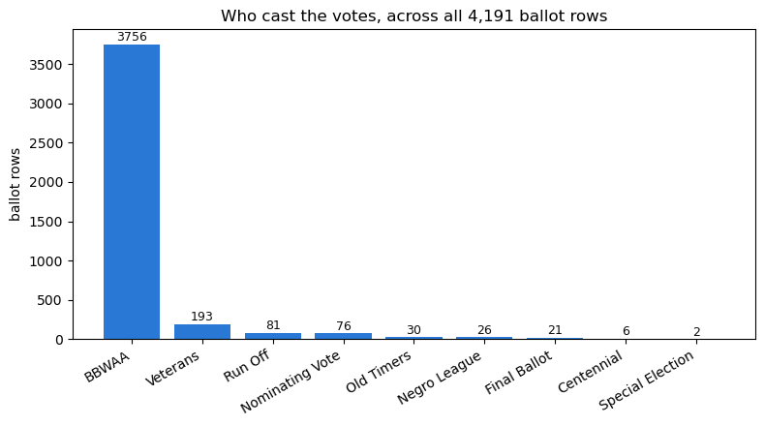
Hall of Fame Records by Voting Organization
How is HOF induction decided ?
BBWAA: 3,756 records
Approximately 89.6% of all records i.e. the BBWAA accounts for nearly nine out of every ten records in the dataset.
Veterans Committee: 193 records
Other voting processes appear less frequently
Figure 2. Number of Hall of Fame voting records by voting organization.
T

Slide 4
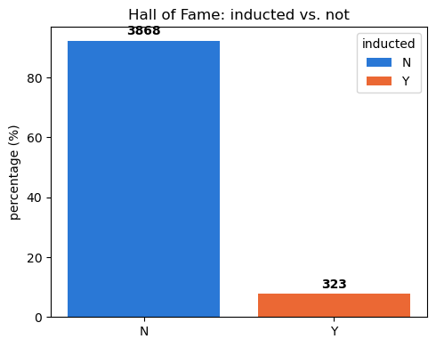
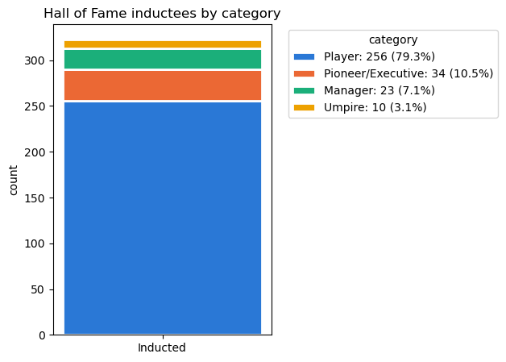
Successful and Unsuccessful Ballot Records
323 successful records
3,868 unsuccessful records
Only 7.7% of all records resulted in induction
Players represented 79.3% of successful induction records
Further investigation: Managers had the higher induction rate (3.28% vs. 1.33% for players)
Figure 3. Number of successful and unsuccessful Hall of Fame records.
Figure 4. Successful induction records by professional category.

Slide 5
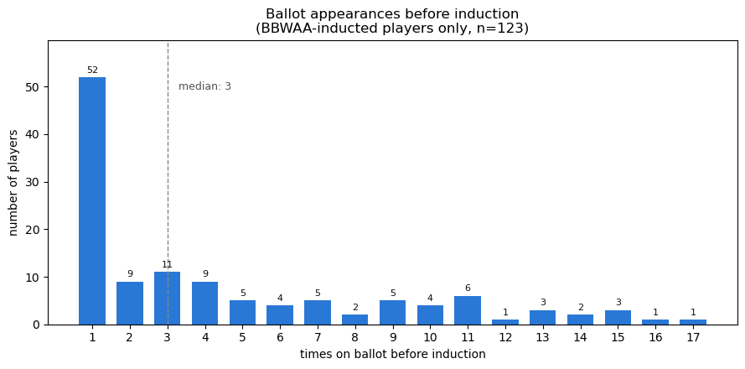
Successful Candidates Follow Different Paths
Among the 123 candidates inducted by the BBWAA:
52 had one recorded appearance
One appearance was the most common result
The median was three appearances
A small number had 15 or more records
Figure 6. Distribution of Hall of Fame record counts for candidates who were eventually inducted by the BBWAA.

Slide 6
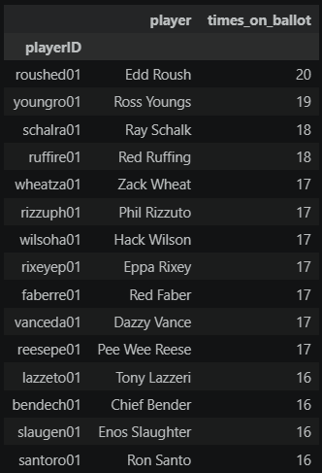
The Longest Successful Path
Appeared in 20 Hall of Fame election-year records
Highest count among the eventually inducted candidates
Not selected through the BBWAA records
Eventually inducted by the Veterans Committee in 1962
Median successful path: 3 records
Longest successful path: 20 records
Table 1. Candidates with the highest number of Hall of Fame election-year records before eventual induction.

Slide 7
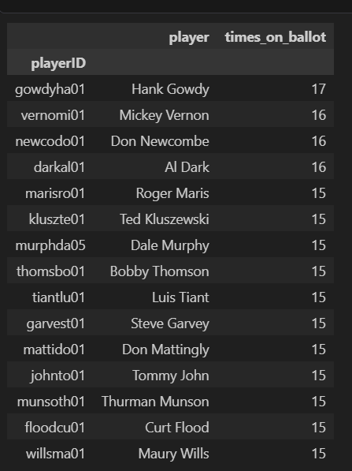
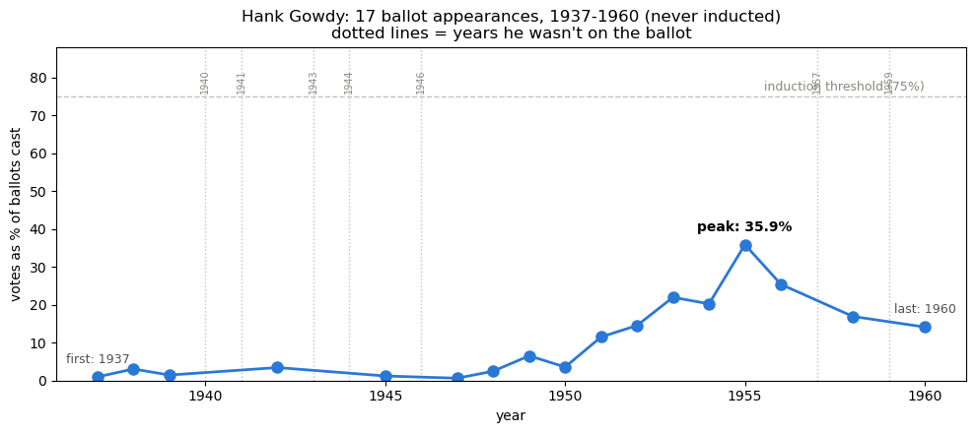
A Long Wait Does Not Guarantee Induction
Hank Gowdy’s voting history
17 Hall of Fame election-year records
Highest record count among the never-inducted candidates examined
Highest displayed support: 35.9%
Threshold shown in the chart: approximately 75%
Table 2. Never-inducted candidates by times on ballot.
Figure 5. Hank Gowdy’s recorded vote percentage by election year.

Slide 8
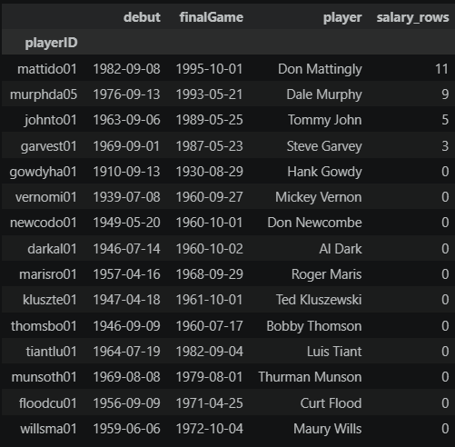
Which Never-Inducted Players Had Salary Data?
We examined 15 frequently considered candidates who were never inducted
The salary dataset covers 1985 to 2016
Only four candidates had available salary records
Don Mattingly had the best coverage, with 11 recorded seasons
Table 3. Salary-data availability for never-inducted candidates.

Slide 9
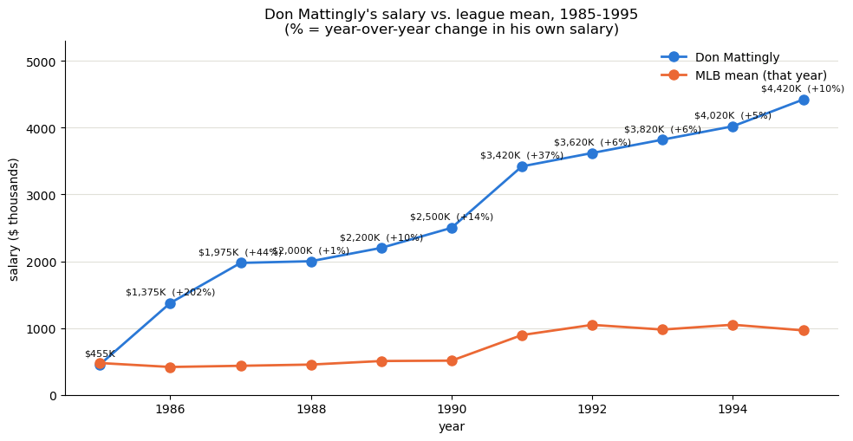
Financial Recognition Without Induction
A Career Can Be Valued Without Hall of Fame Induction
Don Mattingly’s salary compared with the MLB mean
11 recorded seasons, from 1985 to 1995
Salary increased from approximately $455,000 to $4.42 million
Salary was above the MLB mean during much of the displayed period
Not inducted in the Hall of Fame records examined
Figure 7. Don Mattingly’s recorded annual salary compared with the MLB mean from 1985 through 1995.

Slide 10
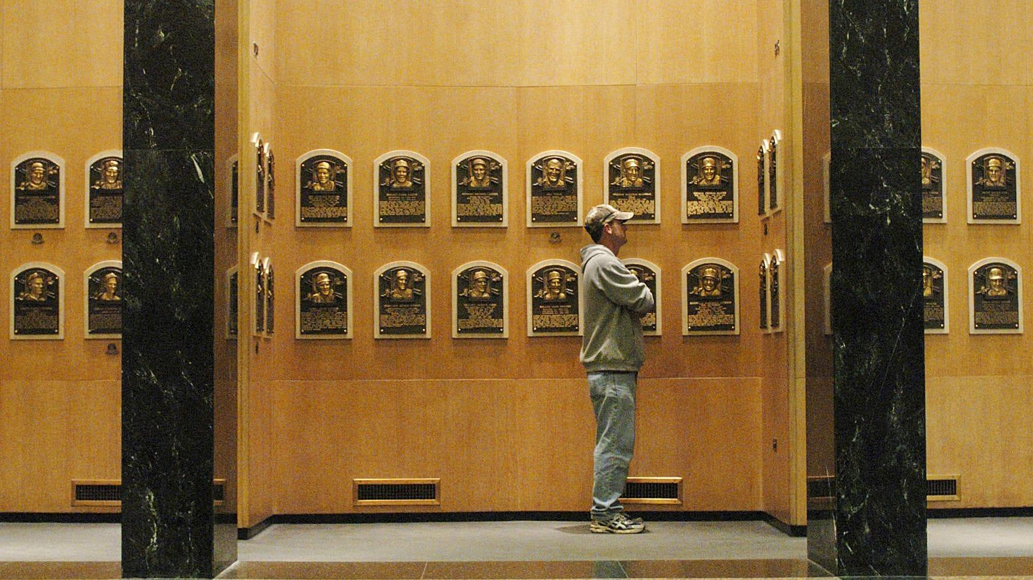
Conclusion
Four Lessons from the Data
The BBWAA contributed most of the voting records.
Most ballot records did not result in induction.
Some candidates were inducted quickly, while others waited many years.
A long voting history did not guarantee induction.
Financial compensation offered another form of career recognition.

